Slide 1
Bayesian Pitch Valuation
By Tony Owens

Slide 2
Baseball Background
In a baseball game, the goal of the pitcher is to get “outs” preventing the offense from scoring. There are three main ways this happens.
The pitcher strikes out the batter
The batter hits the ball, and it is caught by the fielder
The batter hits the ball, and a fielder throws the ball to a base before the corresponding runner reaches the base.

Slide 3
Baseball Background Cont.
The “state” (runners on base and outs recorded) of an inning will influence how the pitcher approaches matchups with batters. For example, if a put in play is likely to result in runs scored, the pitcher may aim to strike out the batter. On the other hand, a pitcher may throw pitches with the goal of creating contact that is better for their team (typically balls hit on the ground).

Slide 4
Performance Tradeoff
Throwing pitches where the batter swings and misses
Highest upside if successful
Useful in any situation
Throwing pitches where the batter does not swing
High upside (largely positive outcomes if successful)
Relies heavily on deception
Most difficult to achieve
Throwing pitches where the batter swings and makes contact
Greatest risk (potential for most negative outcomes)
Used sparingly (typically situation dependent)
Puts faith in the team defense

Slide 5
Utility of the Model
This brings us to the central goal of the model. As demonstrated, the value of a pitch is situationally dependent. That is to say, a pitch can provide great value when thrown in a particular situation, but little to no value in other situations. A Bayesian approach which produces probability distributions as outputs is preferable here since it accurately reflects the uncertainty attached to a given pitch.

Slide 6
Existing Models
One of the most common ways to value pitches is “Stuff” models. These models utilize the qualities of a pitch and assign it a score representing its value. These models are typically situationally agnostic. This constraint limits the ability of a user to determine the value of a pitch in a given situation. Stuff models are still useful in determining a pitcher’s overall ability, but my approach aims to provide greater granularity to pitcher evaluation.

Slide 7
Evaluation Metric
Similar to many publicly available models, the pitch value will be determined based on the change in run expectancy before and after the pitch is thrown. This is used as a proxy to determine how a pitch contributed to a team’s chance of scoring/winning.

Slide 8
Data Used
This project makes use of two data sources:
Statcast data from 2018-2023 (excluding the COVID-19 shortened 2020 season) acquired using the BaseballR package.
Fangraphs data to serve as a reference/point of comparison.

Slide 9
Statcast Data
Statcast data provides pitch level data, which includes pitch location, movement, speed, and the result of the pitch. This is a widely used publicly available data source which the MLB teams also use in their analysis of players. The 2023 dataset has just under 750,000 rows and 164 columns. The full dataset contains around 4.2 million rows.

Slide 10
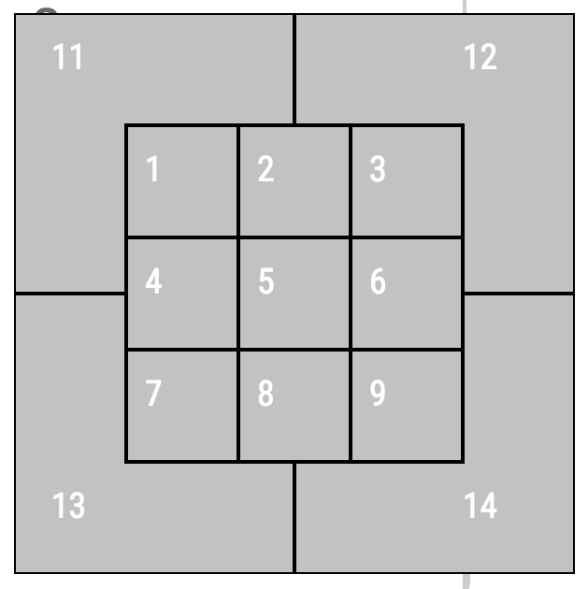
Statcast Zone Primer
The Statcast data groups pitch locations into zones as shown. The zone will greatly influence the swing rate and contact rate, as pitches in certain zones are easier to hit than others. Zones 1-9 are in the strike-zone and 11-14 are outside the strike-zone.

Slide 11
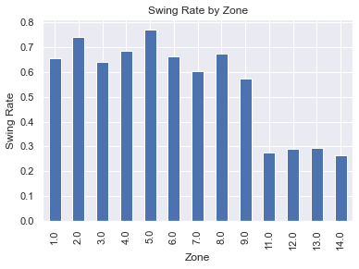
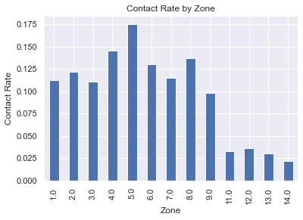
Statcast Data EDA Examples

Slide 12
Fangraphs Data
The Fangraphs data contains season-level pitch valuations from the popular valuation models. This data is useful in comparing my model to the existing models to see where it performs similarly and where there are differences. This data is from 2022-2023. There are 19 columns and 89 rows, with each row corresponding to a pitcher.

Slide 13
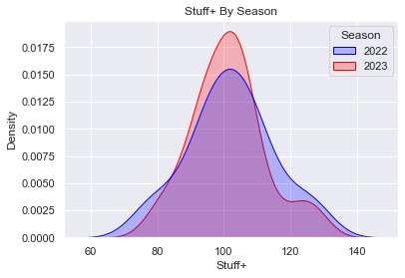
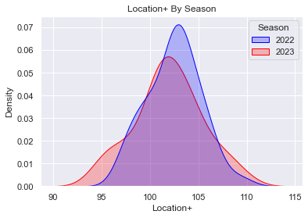
Fangraphs Data EDA

Slide 14
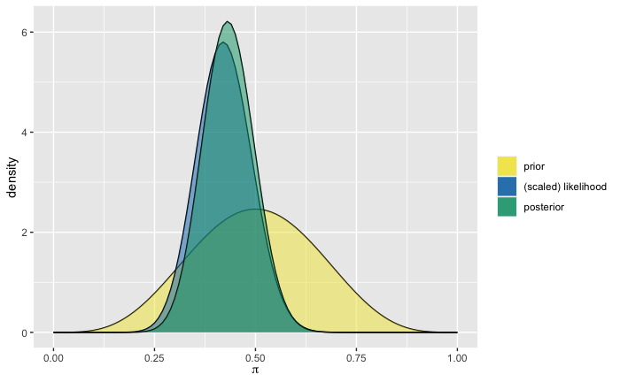
Conjugate Priors
For my conjugate priors, I estimate what percentage of pitches are swung at. I began with a Beta(5,5) assuming without much confidence that around 50% of pitches are swung at. I sampled 50 pitches from 2023 and found that 21 were swung at. Evaluating this yields the following Beta(26,34)

Slide 15
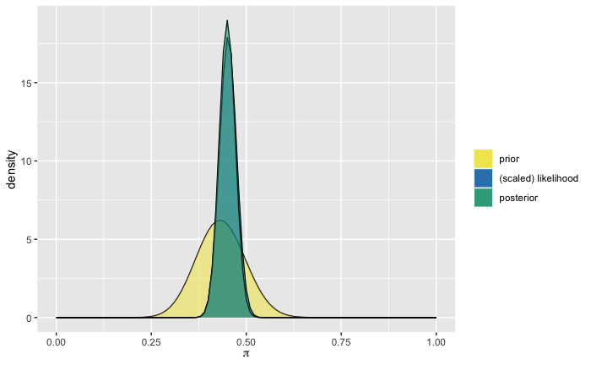
Conjugate Priors Cont.
Perhaps I was not satisfied with only sampling 50 pitches. I decided to sample again, this time sampling 500 pitches with the Beta(26,34) as the prior. In the 500 pitches I observed, 224 were swung at. I now have a Beta(252,308). I am significantly more confident in my belief that around 45% of pitches are swung at, with a range that hovers between 40 and 50%.

Slide 16
Next Steps
The model will consist of three main components, an evaluation of the batter’s likelihood to swing at a pitch, an evaluation of the batter’s likelihood to make contact with the pitch, and an estimation of their value should they not swing, swing and make contact and swing and fail to make contact. In the coming weeks, I aim to focus on generating probability distributions detailing the batter’s likelihood to swing at a pitch given the aforementioned factors.

Slide 17
Questions?

